Slide 1
SLO Music Research Project
SLO Music Research Project
First Name, Middle Initial(s), Last Name
Author's Affiliation
Course Number and Name(s)
Instructor's Name
Assignment Due Date

Slide 2
johann sebastian bach
Johann Sebastian Batch was a German composer born on the 31st march 1685 and died on July 28, 1780. He was born in Eisenach, Thuringia, Ernestine Saxon Duchies and died at Leipzig.
He was a composer in the Baroque era, the most famous and celebrated member of a large family of north German musicians.
A memorable quote by Johann Sebastian Batch ““Music is an agreeable harmony for the honor of God and the permissible delights of the soul.”

Slide 3
time period and location in which johann sebastian bach lived
In present day he is considered as one of the best and greatest western composers of all time.
He was born in Eisenach, Thuringia, Germany and he came from a family of musicians stretching from generations behind him. His Dad, Johann Ambrosius, worked as the town musician in Eisenach, and it is believed that he taught young Johann to play the violin.
At the age of seven, he was enrolled to school and he received religious teachings and studied Latin and other subjects.
His Lutheran faith influenced his musical work .

Slide 4
Continued
At the age of 10, his parents died and he went to live with his brother who was an organist who taught Bach how to taught him how to play a keyboard.
At school, Bach did well at school and he was selected to join a choir of the poor boys in the school of Michaelskirche, Lüneburg, Germany.
He worked as an organist, then as a court composer at Cöthen and then as musical director at St Thomas's church in Leipzig, producing many hundreds of choral and instrumental works (and hundreds of thousands of pages of handwritten parts)

Slide 5
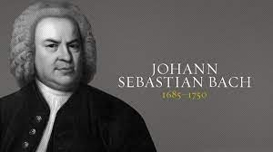
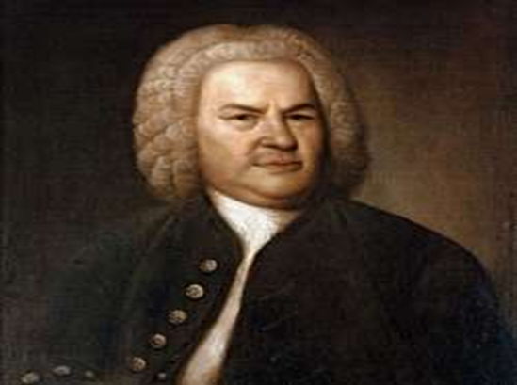
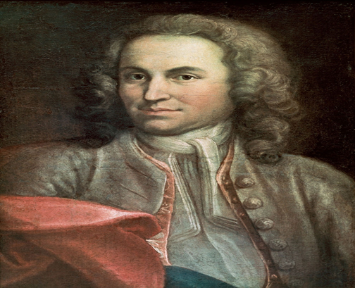
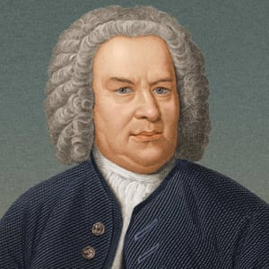
JOHANN SEBASTIAN BACH IMAGES
Retrieved from: https://www.biography.com/musician/johann-sebastian-bach
Notehttps://www.biography.com/musician/johann-sebastian-bach

Slide 6
Interesting personal information about johann sebastian bach
Johann married twice and had 8 surviving children's, three of whom later became reputable composers in their own right.
He was a religious man, however his first wife died when he was far away conducting personal business.
Unfortunately, 12 of his 20 children died while they were still infants.
One of his son disappeared from home under mysterious circumstances while he had a son who had learning difficulties

Slide 7
JOHANN SEBASTIAN BATCH MUSICAL ELEMENTS
Johann style of music was baroque, that was characterized by a lot of notes, steady shifts of underlying harmony, and simple motoric rhythms.
Some described his music as ‘sewing machine music’
His music also featured extra ordinary jazzy chords and some exciting dissonance.
His music was absolute music meaning his music could work effectively on a guitar as well as a piano, as a choral work or even as an orchestral arrangement

Slide 8
Continued
Batch excelled at fugue as well as counterpart music.
A fugue is a kind of musical chase between two or more lines. the first line starts; after a few seconds the second line joins in.
Keyboard and chords were his main musical instruments.
He was an expert storyteller as well, often using melody to suggest actions or events.
Bach used counterpoint, the playing of multiple melodies simultaneously, and fugue, the repetition of a melody with slight variations, to create richly detailed compositions.

Slide 9
Alberto Ginastera
Alberto Evaristo Ginastera was born on April 11 1916, in Buenos Aires, Argentina to a Catalan father and an Italian mother and died on June 25, 1983, in Geneva Switzerland.
He was one of the leading 20th century Latin- American composer. He was famous due to his use of local and national musical idioms in his compositions.
Alberto studied music privately as a child, later enrolling at the National Conservatoire of Music in his home city.

Slide 10
time period and location in which Alberto Ginastera lived
Alberto enrolled at the National Conservatoire of Music in his home city.
On the year 1946-1947, Alberto spent an year in the united states on a Guggenheim fellowship.
He later joined the teaching staff at the national conservatory
He also became the Dean of the faculty of musical art and sciences at the catholic university.
Alberto featured in his first opera Don Rodrigo

Slide 11
Continued
In the early 1950s, the nationalist element in his music gradually lost its dominance, and more explicitly modernist characteristics began to make their presence felt in what Ginastera called his ‘neo-expressionistic period’.
He actively adopted the twelve-tone technique and his works also incorporated microtones and polytonality. by the time of his death, on June 25, 1983, his modernism had softened, and he began to look again at the tonality and folk-music inflexions of his early output.

Slide 12
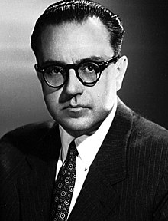
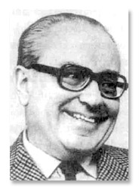
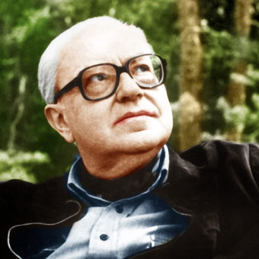
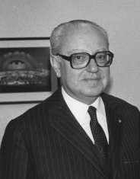
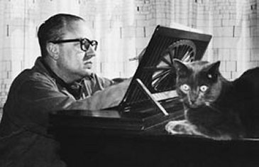
Alberto Ginastera IMAGES
https://www.biography.com/musician/Alberto Ginastera

Slide 13
Interesting personal information about Alberto Ginastera
He won his first prize at the age of 22 for Piezas infantiles for piano.
His political views on the Peron government put him in trouble and this forced him to resign at the National university of La Plata and at the National Military Academy.
Personal problems also affected his productivity in the 1960’s.
He divorced his first wife and married a second wife and retired to Switzerland where he died.

Slide 14
Alberto Ginastera MUSICAL ELEMENTS
Alberto grouped his music into three different periods and they include; the “objective Nationalism, the subjective nationalism and the Neo-expressionism.
Some of musical work included; operas, Orchestral, Ballets ,Concertante, incidental music, chamber music, vocal /choral music, organs and piano.
Some of the musical instruments Alberto played were; piano, and violin
A memorable quote by Alberto “Be entirely tolerant or not at all; follow the good path or the evil one”.

Slide 15
Comparing Alberto Ginastera and johann sebastian bach work
Johann music was during the baroque era. music, like the architecture and painting of the time while Alberto Ginastera music was more of a the nationalist element.
Johann music work was influential in the 18th century and was considered one of the best of the greatest composers of all time. Alberto Ginastera was one of the greatest musician in the 20th century
Both their work included musical instruments that included; piano, and other musical instruments.

Slide 16
So what?
It is amazing how these two artists did their work despite the lack of modern technology.
Their music lay foundation to modern day music.
Both artist were considered as the elites during the 18th and 20th century

Slide 17
References
Alberto Ginastera- Bio, Albums, Pictures – Naxos Classical Music. (n.d.). Www.naxos.com. https://www.naxos.com/person/Alberto_Ginastera/26054.htm
Alberto Ginastera: Biography. (n.d.). Www.boosey.com. https://www.boosey.com/pages/cr/composer/composer_main?composerid=2699&ttype=BIOGRAPHY
CHASE, G. (1957). ALBERTO GINASTERA: ARGENTINE COMPOSER. The Musical Quarterly, XLIII(4), 439–460. https://doi.org/10.1093/mq/xliii.4.439
Hertzmann, E., Bach, J. S., David, H. T., & Mendel, A. (1945). The Bach Reader. A Life of Johann Sebastian Bach in Letters and Documents. Notes, 3(1), 40. https://doi.org/10.2307/891187
Johann Sebastian Bach. (2017, April 28). Biography. https://www.biography.com/musician/johann-sebastian-bach

Slide 18
Continued
Marshall, R. L., & Emery, W. (2019). Johann Sebastian Bach | Biography, Music, & Facts. In Encyclopædia Britannica. https://www.britannica.com/biography/Johann-Sebastian-Bach#ref12102
Miller, C. K., Spitta, P., Bell, C., & Fuller-Maitland, J. A. (1952). Johann Sebastian Bach; His Work and Influence on the Music of Germany, 1685-1750. Notes, 9(2), 292. https://doi.org/10.2307/890232
Wight, C. (2019). Johann Sebastian Bach (1685-1750). Www.bl.uk. https://doi.org/http://www.bl.uk/onlinegallery/onlineex/musicmanu/bach/index.html

